Slide 1
BASH script to get Date,Public IP,Private IP,Host name,Last reboot time,Number of CPUs,Server architecture & Server type

Slide 2
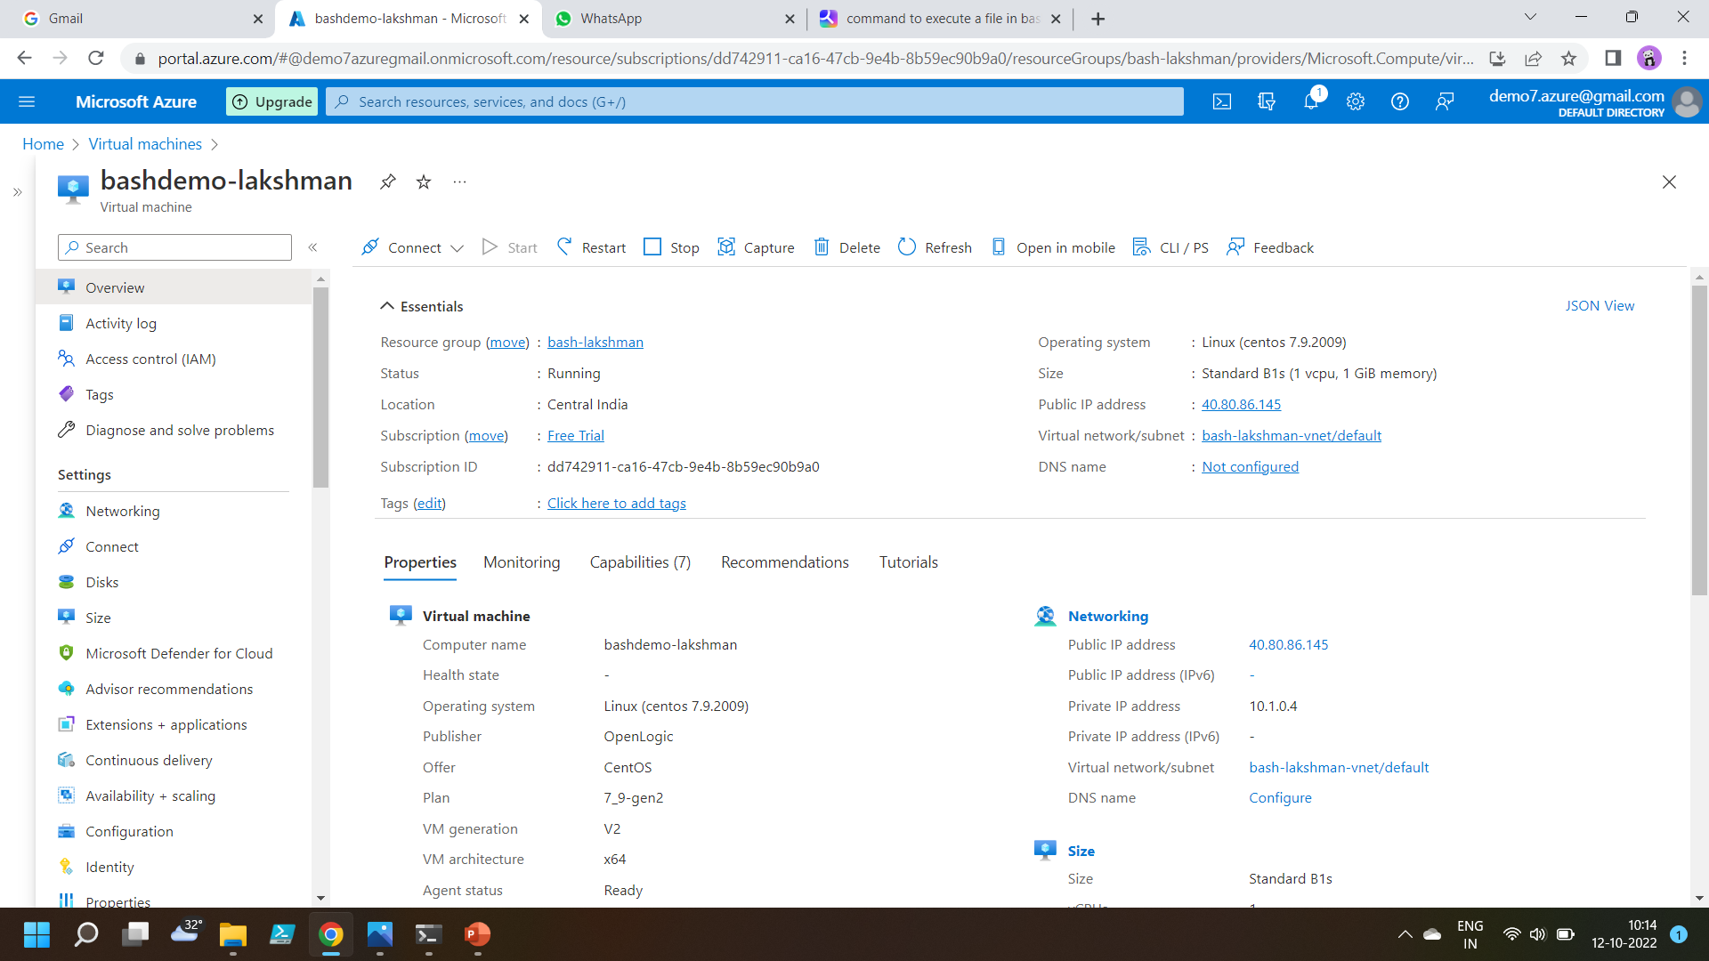
Created a CentOS machine

Slide 3
Commands
Touch (file name) → to create a file
Chmod +x(file name) →to make the file executable
Sh (file name) → to execute the file
Vim (file name) → to edit the file

Slide 4
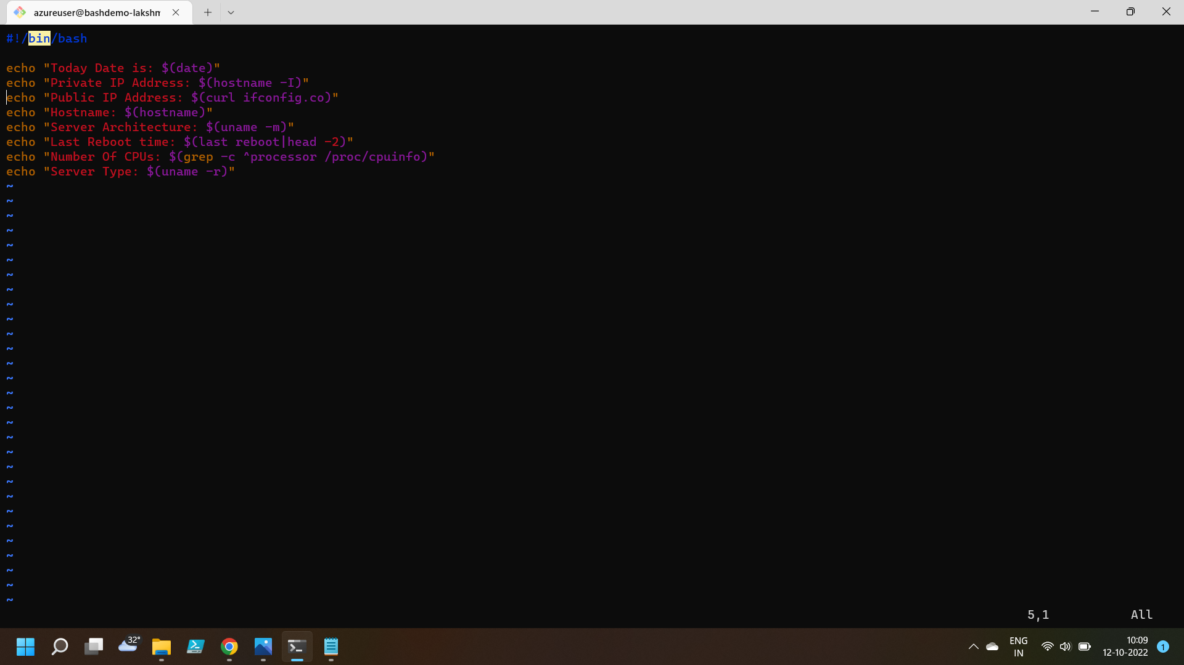
Passing commands to get the desired output

Slide 5
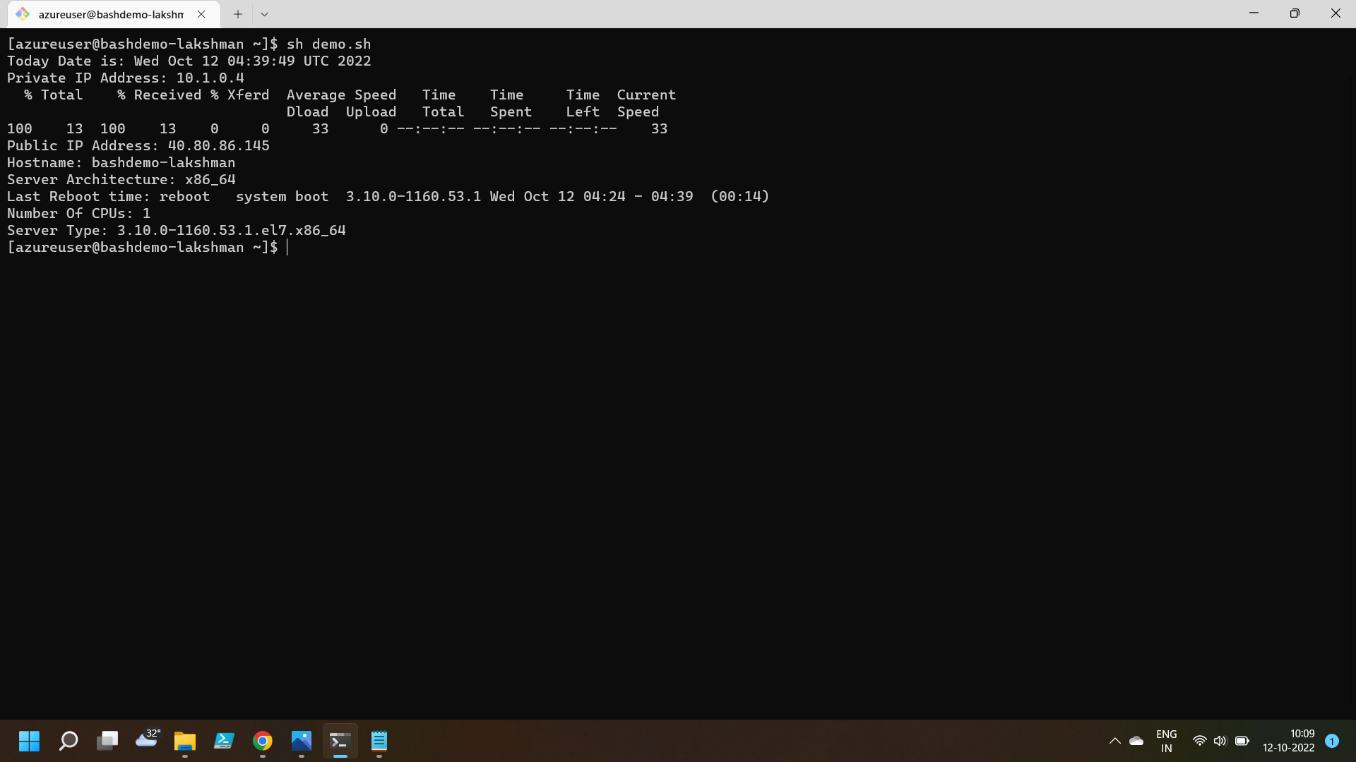
Output

Slide 6
Thankyou

